Slide 1

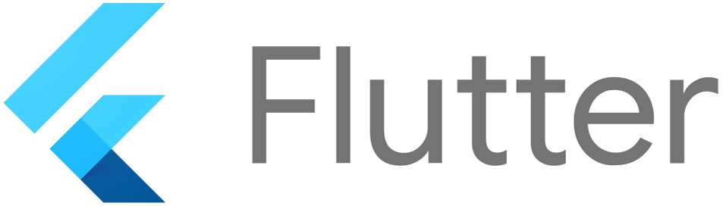
DART AND FLUTTER

Slide 2

WHAT IS DART..??
Dart is an open-source and object-oriented programming language. It is originally developed by Google and later approved as a standard by ECMA (European Computer Manufacturers Association).
The purpose of Dart programming is to create a frontend user interfaces for the web and mobile apps.

Slide 3
DART AS FOUNDATION OF FLUTTER
Dart also forms the foundation of Flutter. Dart provides the language and runtimes that power Flutter apps, but Dart also supports many core developer tasks like formatting, analyzing, and testing code.

Slide 4
DART VS JAVASCRIPT
Similarly to JavaScript, Dart can be used for both mobile and web
development. Dart became popular along with the Flutter framework
for developing cross-platform mobile
apps. Dart can be also used for developing web apps, but is actually used for this purpose very rarely.

Slide 5
EDITORS
On November 18, 2011, Google released Dart Editor, an open-source program
for macOS, Windows, and Linux. The editor supports syntax highlighting, JavaScript compiling, running web, server Dart applications, and debugging.

Slide 6
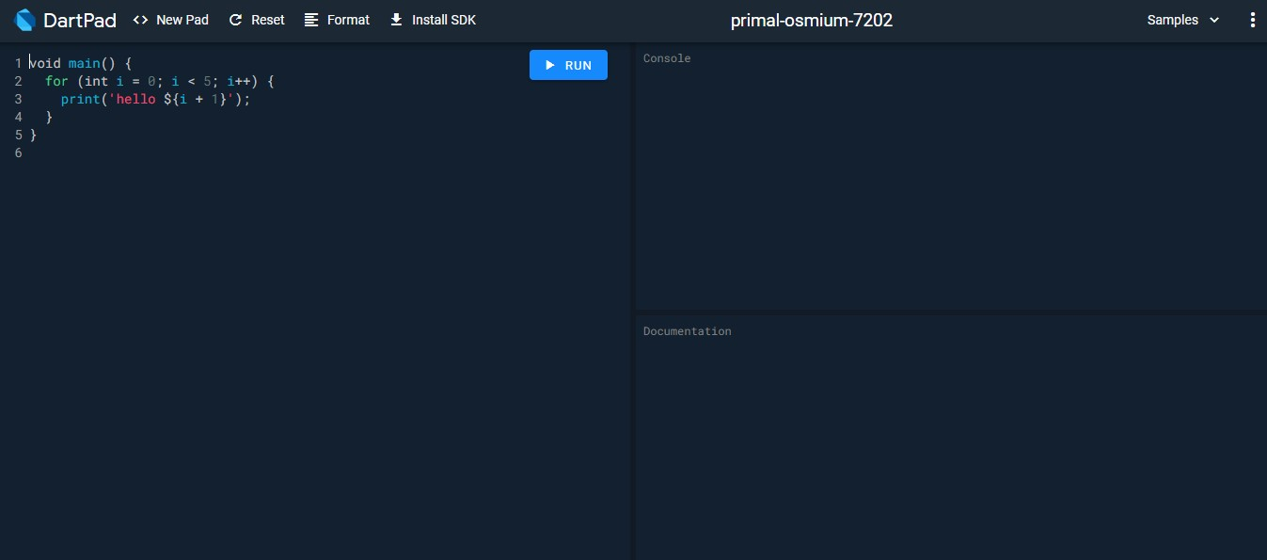
DARTPAD
The Dart team created DartPad at the start of 2015, to provide an easier way to start using Dart. It is a fully online editor from which users can experiment with Dart application programming interfaces (APIs), and run Dart code.

Slide 7
The main() function:
The main() function is the top-level function of the Dart. It is the most important and vital function of the Dart programming language. The execution of the programming starts with the main() function.
The main() function can be used only once in a program.
It is responsible for all types of execution such as user-defined statements, functions, and libraries function. The program begins with main() function and we declares variable, and user defined executable statements inside it. The main function returns void

Slide 8
SYNTAX:
void main() {
// main function body
}
Example:
void main()
{
print(“Hello World");
}
Output:
Hello World

Slide 9
WHERE CAN I USED DART..??
Dart is a general-purpose language, and you can use it for almost anything:
.) In mobile applications thanks to Flutter.
.) In console applications.
.) In web applications

Slide 10
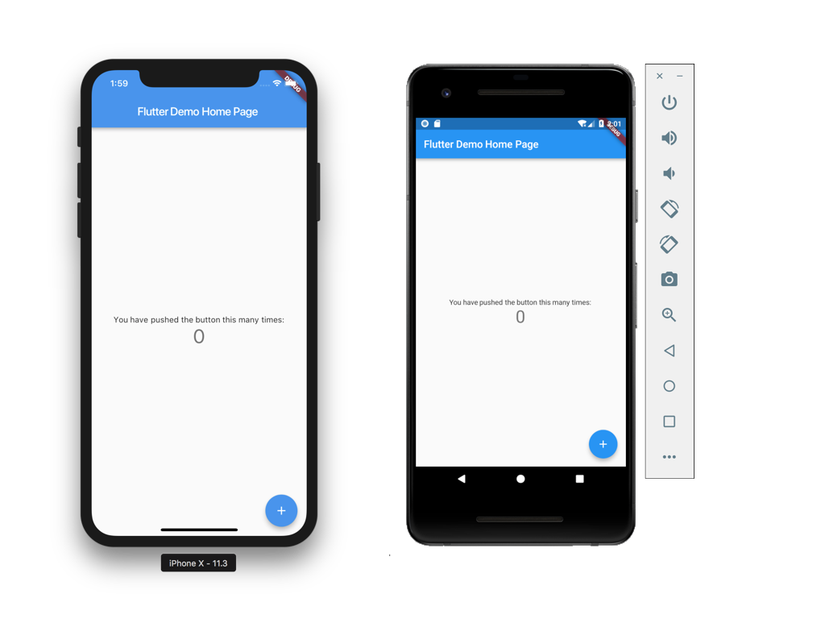
WHAT IS FLUTTER..??
Flutter is an open-source
UI Software Development Kit created by google,
which allows you to make cross platform applications (Android and iOS).

Slide 11
WHY FLUTTER..??
Following are some benefits of flutter:
.) FLUTTER IS CROSS-PLATFORM
Flutter is a cross-platform development tool. That means software developers can use the same code base for building an iOS and Android app. Cross-platform development is the best method for saving time and resources throughout the development process.

Slide 12
.) SIMPLE TO LEARN AND USE
Flutter is a modern framework, and you can feel it! It’s way simpler to create mobile applications with it. If you have used Java, Swift, or React Native, you'll notice how Flutter is different.

Slide 13
.) QUICK COMPILATION (HOT RELOAD)
You can change your code and see the results in real-time. It’s called Hot-Reload. It only takes a short amount of time after you save to update the application itself.
Significant modifications force you to reload the app. But if you do work like design, for example, and change the size of an element, it’s in real-time!

Slide 14
.) Good documentation.
It’s important for new technology to have good documentation. But it’s not always the case that it has it!
You can learn a lot from Flutter's documentation, and everything is very detailed with easy examples for basic use cases.

Slide 15
.) OPEN SOURCE
Flutter is an open-source technology surrounded by an active community of developers who provide support, contribute to the tool’s extensive documentation, and develop helpful resources. Both Dart and Flutter are free to use.

